Slide 1
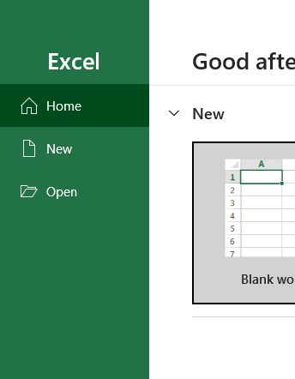
Excel for Data Analytics
– A Beginner's Guide

Slide 2
Introduction to Excel
Data analysis is the process of inspecting, cleaning, transforming, and modeling data to extract valuable information, uncover patterns, and support decision-making. Using tools like Microsoft Excel for data analysis makes this process accessible and efficient.
Explain why Excel is a fundamental tool for data analysis.
It offers a wide range of functions for statistical and logical calculations.
Visualization tools like charts and conditional formatting help present data effectively.
PivotTables and Solver enable advanced analysis for large datasets.

Slide 3
Basic Excel Functions
Basic cell operations
Entering data in cells
Using formulas and functions
Cell referencing
Absolute Reference ($A$1): the reference does not change when copied to another cell.
Relative Reference (A1): the reference adjust based on the new cell.
Commonly used functions
SUM(range): Adds values in a given range.
AVERAGE(range): Calculates the mean of a range of values.
COUNT(range): Counts the number of numeric entries in a range.
Basic text functions
CONCATENATE(A1, B1): Combines text from multiple cells.
LEFT(A1, n): Extracts the first n characters from a string.
RIGHT(A1, n): Extracts the last n characters from a string.

Slide 4
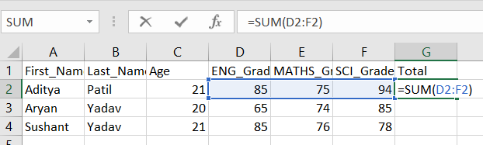
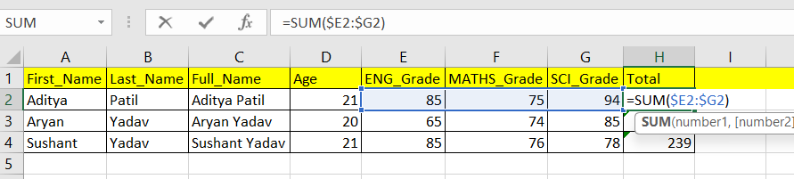
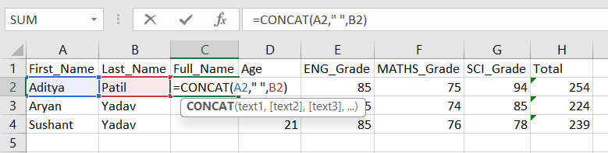
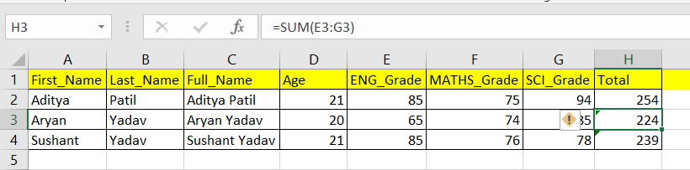
Examples
Sum function example
Absolute reference example
SUM function
Concatenate function example
Relative reference example
CONCAT function

Slide 5
Data Manipulation
Sorting and Filtering
Sort data in ascending/descending order.
Use filters to display specific data subsets.
Conditional Formatting
Highlight cells based on conditions (e.g., values greater than a threshold).
Apply colour scales and icon sets for quick data insights.
Removing Duplicates
Identify and delete duplicate values to clean up datasets.

Slide 6
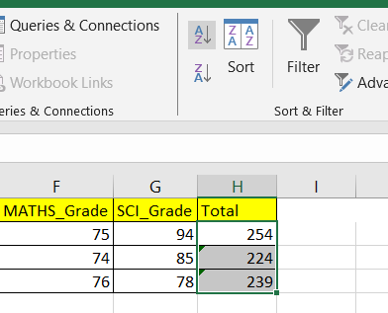
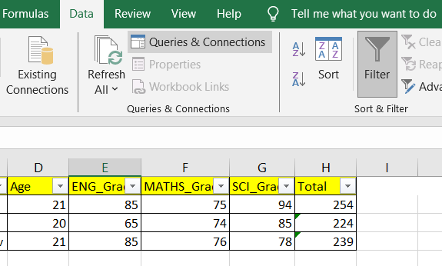
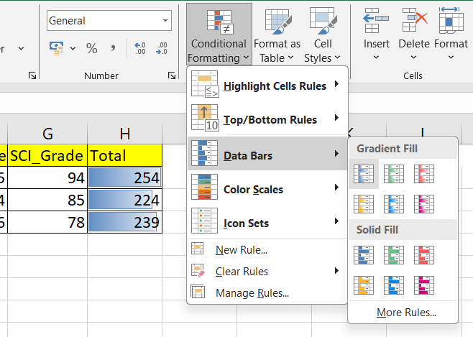
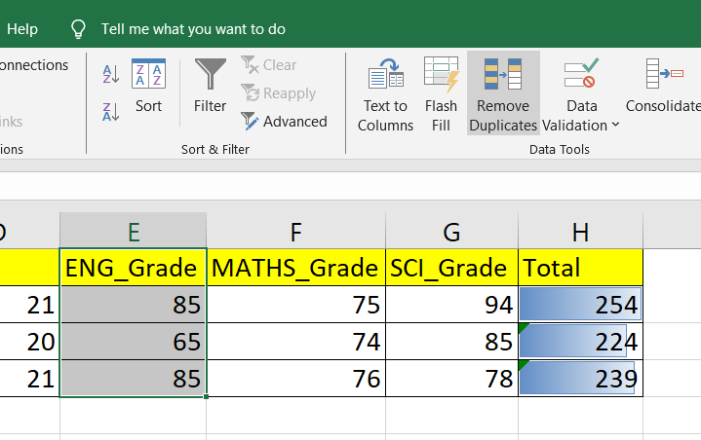
Examples
Sorting
Filtering
Conditional formatting
Remove duplicates

Slide 7
Data Visualization
Creating Charts
Generate bar, line, and pie charts to represent data visually.
Customize chart elements such as titles, legends, and axes for better readability.
Combine multiple chart types for better data representation.
Conditional formatting with data bars and color scales
Use data bars and color scales to highlight trends.
Apply icon sets to provide visual cues for numerical changes.
Sparklines
Insert mini-charts within cells for quick trend analysis.
Choose between line, column, and win/loss sparklines based on data representation needs.
Customize sparkline colours and styles for better visualization.

Slide 8
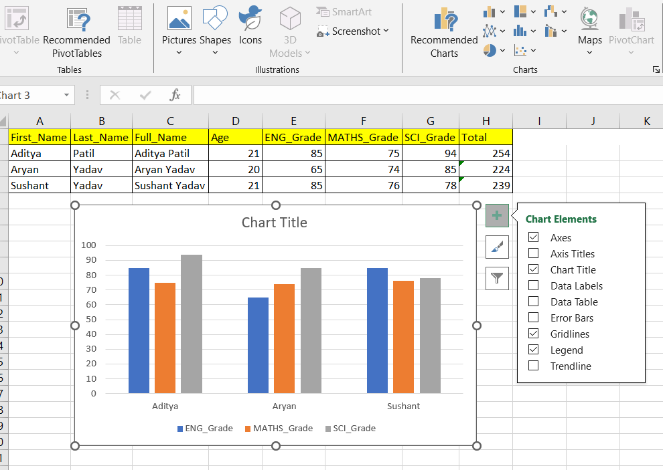
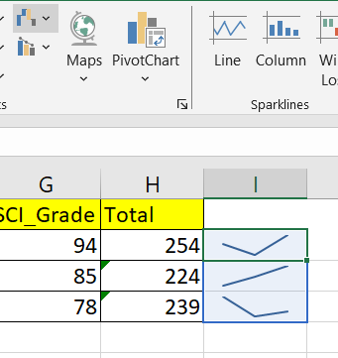
Examples
Range
Customize chart
Bar Chart
Chart types
Sparklines graph
Filter data
Customize chart elements

Slide 9
Pivot Tables
How to create and use pivot tables
As Inserting a Pivot Table: Select your dataset, go to Insert > PivotTable, and choose a location.
Building a Pivot Table:
Drag and drop fields into Rows, Columns, Values, and Filters.
Use "Sum," "Count," or "Average" for numerical data.
Apply sorting and filtering to refine the displayed data.
Summarizing data with pivot tables
Grouping Data: Categorize dates, numbers, or text for better analysis.
Applying Calculations: Use built-in calculations like percentages, running totals, and difference comparisons.
Refreshing Data: Update pivot tables when source data changes using Refresh.

Slide 10
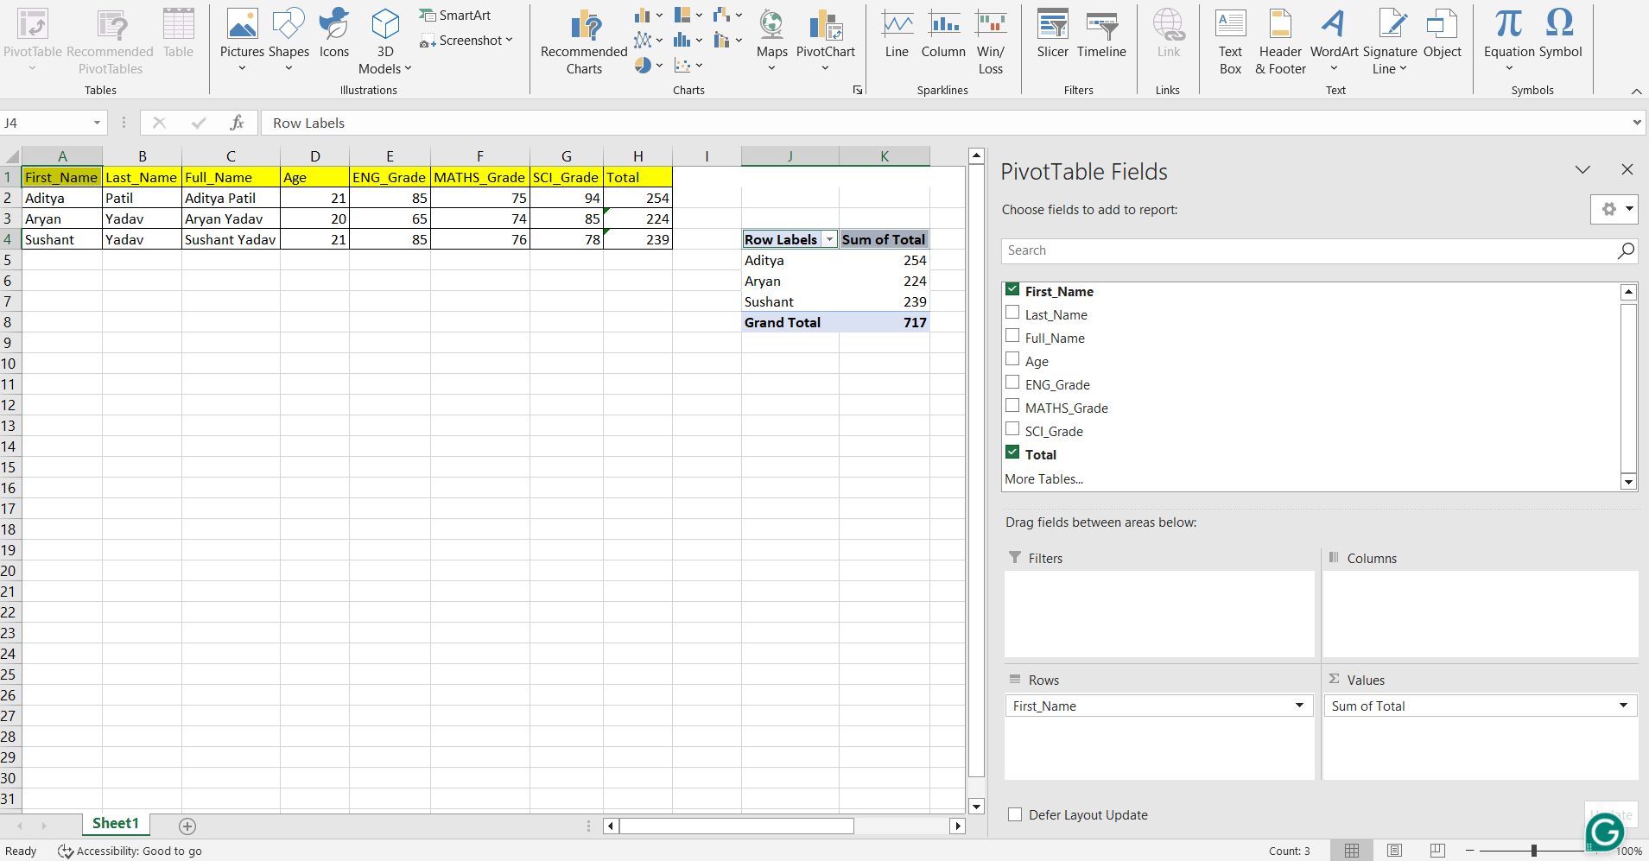
Example
Pivot table
Customization
Pivot table
Filter conditions
Enter row and columns
Values to arrange accordingly

Slide 11
Data Analysis Tools in Excel:
Introduction to "What-If Analysis“
Goal Seek: This allows you to determine the necessary input value to achieve a specific output.
Data Tables: Helps in analyzing multiple scenarios by changing one or two input values to see how they impact results.
Solver
A powerful tool used for optimization problems, where you define a target value, adjustable inputs, and constraints
Data Validation
Set conditions such as only allowing text inputs of a certain length or enforcing a specific format.
Provide users with informative messages when invalid data is entered, improving data specific-quality.

Slide 12
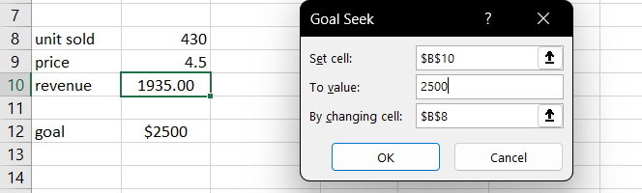
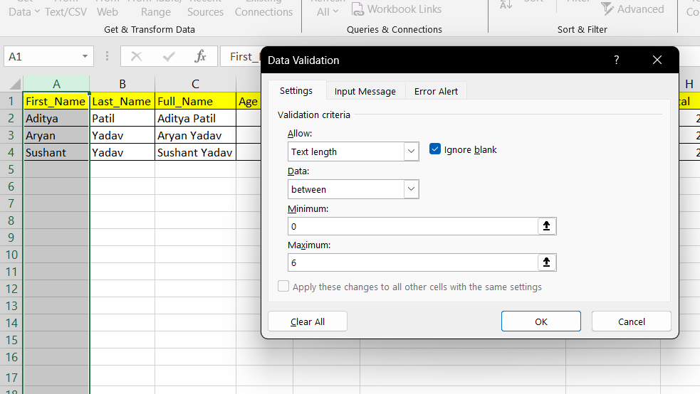
Example
Objective cell
Data type
GoalSeek
Objective value
Conditions
Data Validation
Variable parameter
Range

Slide 13
Basic Excel Macros
Macros allow users to automate repetitive tasks in Excel, reducing manual work and increasing efficiency.
Recording and Running Macros
To record a macro, go to View > Macros > Record Macro, perform the desired actions, and then stop recording.
Macros can be assigned to buttons or shortcut keys for quick execution.
Use the Macro Editor (Alt + F11) to modify recorded macros or create custom VBA scripts for more advanced automation.

Slide 14
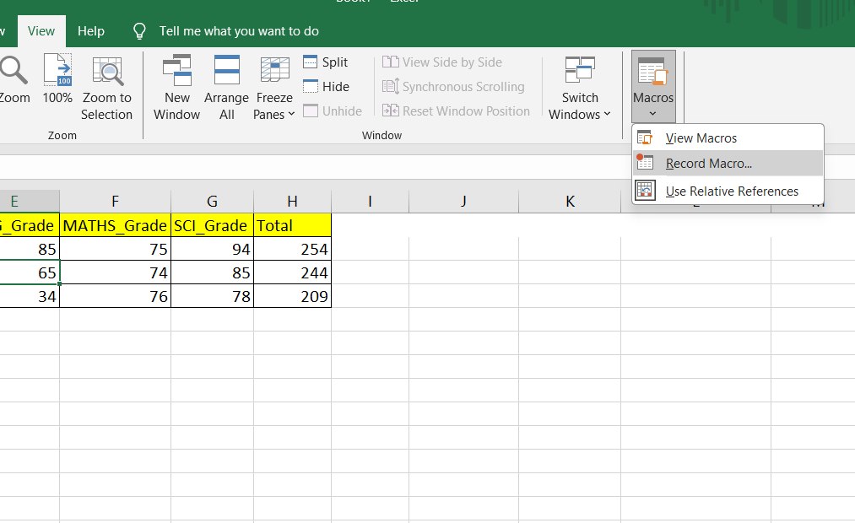
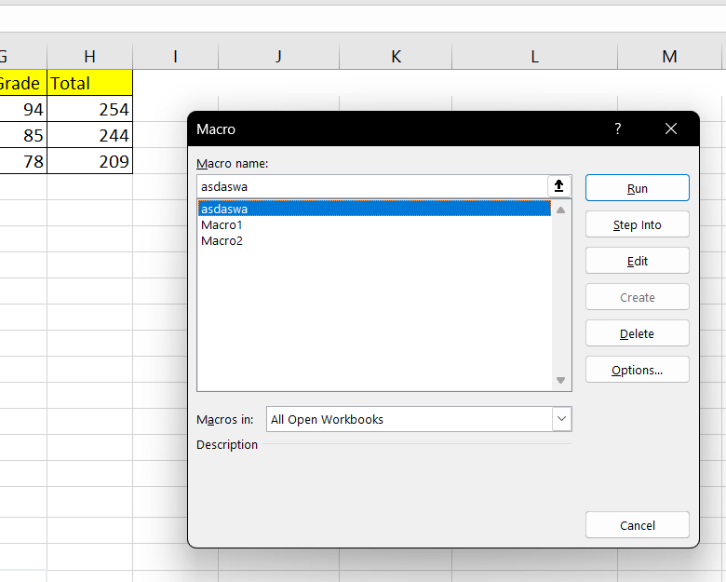
Example
Record a macro
Run recorded macro
View recorded macro
Write name
Create a macro

Slide 15
Shortcuts and Tips
Workbook Shortcut Keys
To create a new workbook - Ctrl + N
To open an existing workbook - Ctrl + O
To save a workbook/spreadsheet - Ctrl + S
To close the current workbook - Ctrl + W
Common Shortcut Keys
Ctrl + C – Copy
Ctrl + V - Paste
Ctrl + Z - Undo
Ctrl + Y - Redo
F2 - Edit cell
Ctrl + A - Select all
Home - Move to the beginning of the worksheet
End - Move to the end of the worksheet
PgUp - Scroll up one page
PgDn - Scroll down one page
Cell Formatting Shortcut Keys
To move to the previous cell - Shift + Tab
To copy and paste cells - Ctrl + C, Ctrl + V
To italicize and make the font bold - Ctrl + I, Ctrl + B
To center align cell contents - Alt + H + A + C
To select all the cells on the right- Ctrl + Shift + Right arrow

Slide 16
Thank You

